Slide 1
W­­­^{ater ­}G^{as} O^{il} Leakage Management Web App
By Mohammed Usama

Slide 2
What is AWS?
Amazon Web Services, Inc. (AWS) is a subsidiary of Amazon that provides on-demand cloud computing platforms and APIs
These cloud computing web services provide distributed computing processing capacity and software tools via AWS server farms.
Fees are based on a combination of usage (known as a "Pay-as-you-go" mode).

Slide 3
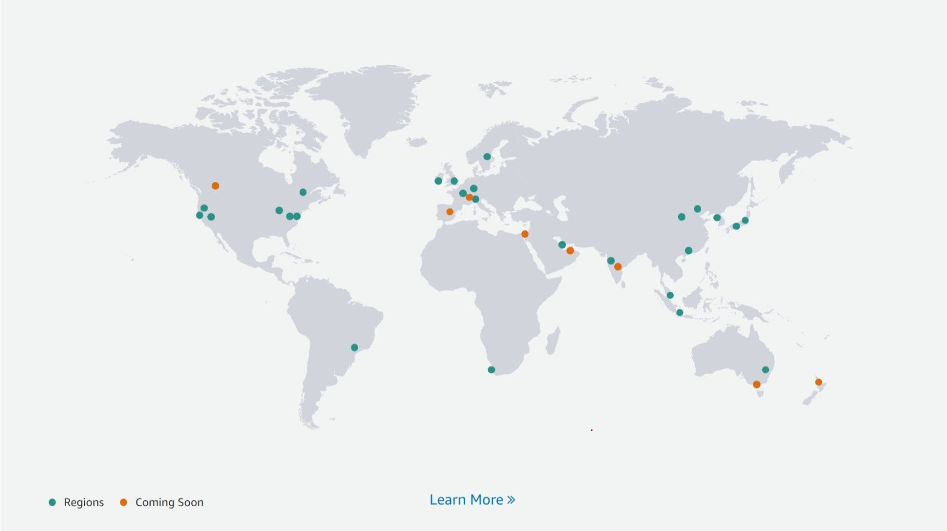
How AWS functions?
AWS has the concept of a Region, which is a physical location around the world where they cluster data centers.
An Availability Zone (AZ) is one or more discrete data centers with redundant power, networking, and connectivity in an AWS Region.
AWS Local Zones place compute, storage, database, and other select AWS services closer to end-users. With AWS Local Zones, you can easily run highly-demanding applications with single-digit millisecond latencies to your end-users e.g. media & entertainment content creation, real-time gaming etc.

Slide 4
Services of Aws that are used in this Project
Amazon’s Simple Storage Service
Amazon S3 offers a range of storage classes designed for different use cases.
Simple Storage Service is an object storage service that offers industry-leading scalability, data availability, security, and performance.
Amazon’s DynamoDB
DynamoDB is a fully managed NoSQL database service that provides fast and predictable performance with seamless scalability.
With DynamoDB, you can create database tables that can store and retrieve any amount of data and serve any level of request traffic.
Amazon’s Lambda Functions
Lambda is a compute service that lets you run code without provisioning or managing servers.
Lambda helps in : run code for virtually any type of application or backend service, runs your code on a high-availability compute infrastructure and performs all the administration of the compute resources, including server and operating system maintenance, capacity provisioning and automatic scaling, code monitoring and logging

Slide 5
Problem & Objective
The idea behind taking this project is Wastage of Resources e.g. When we see Water Leakage from under ground Pipelines but we can’t do anything because reporting these issues takes a lot of time and effort.
That’s why I have created this project where User can report these issues with ease.
Objectives :
• To develop a fully working web app which can help the authority and user to save resources or other resources or lodge a complaint regarding some issues.
• Report any Water leakage, Gas leakage, Oil leakage in underground/Above ground pipelines, and Garbage piles along the road.
• Saves the data entered by the user to take necessary action.
• To design a user-friendly GUI which suit the user.
• To reduce the paperwork.

Slide 6
Features
• Different options for Admin Login and Complaint Registration
• Keep record of the locations and issues inputted by the user
• Using Geo-Location API so that authority gets the latitude and l longitude of issue.
• Display a map so that user can pinpoint the exact spot of leakage or his/her issue.
• User fills a form, for describing more about the leakage and some personal information along with uploading some photos of the issue.
• The authority acts upon the information provided by the user.

Slide 7
How things are working
Register Complaint Button clicked
Fetches Location of User
User Have to Pinpoint the location on the map
User have to fill the form
Upload photos if any
Form Submitted. Complaint Registered
Main Page: Front End
Form data goes to DynamoDB Using AWS API Gateway and AWS Lambda Function
Photos uploaded by user goes to AWS S3 bucket using Lambda Function
Post Request is generated
Main Page: Back End
A GET request is generated when some one login to Admin Page.
JSON data is parsed is Printed in readable format (like a table)
if user decide to Delete the row, then a DELETE request goes to the server and a Custom Delete lamda Function deletes the row
If user decides to see the Photos for that row, then a Lambda function Fetches the Photos for that row.
Admin Page

Slide 8
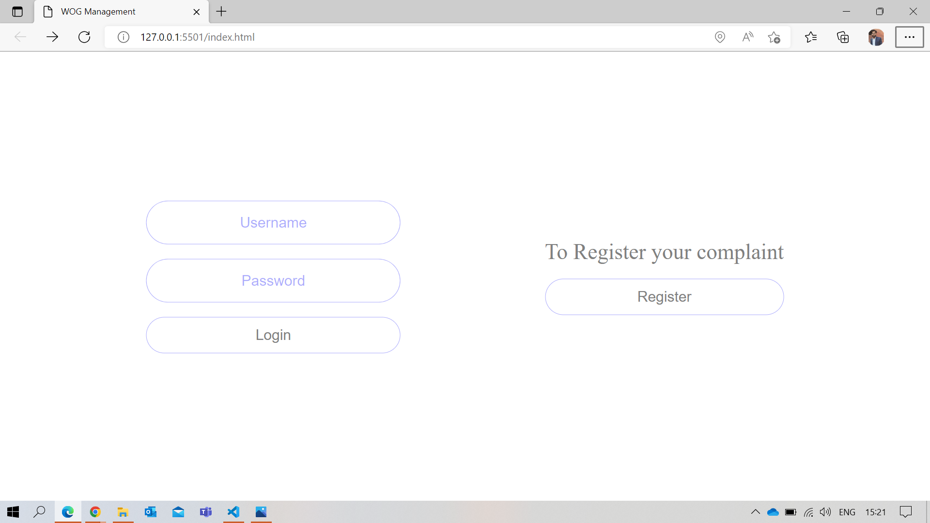
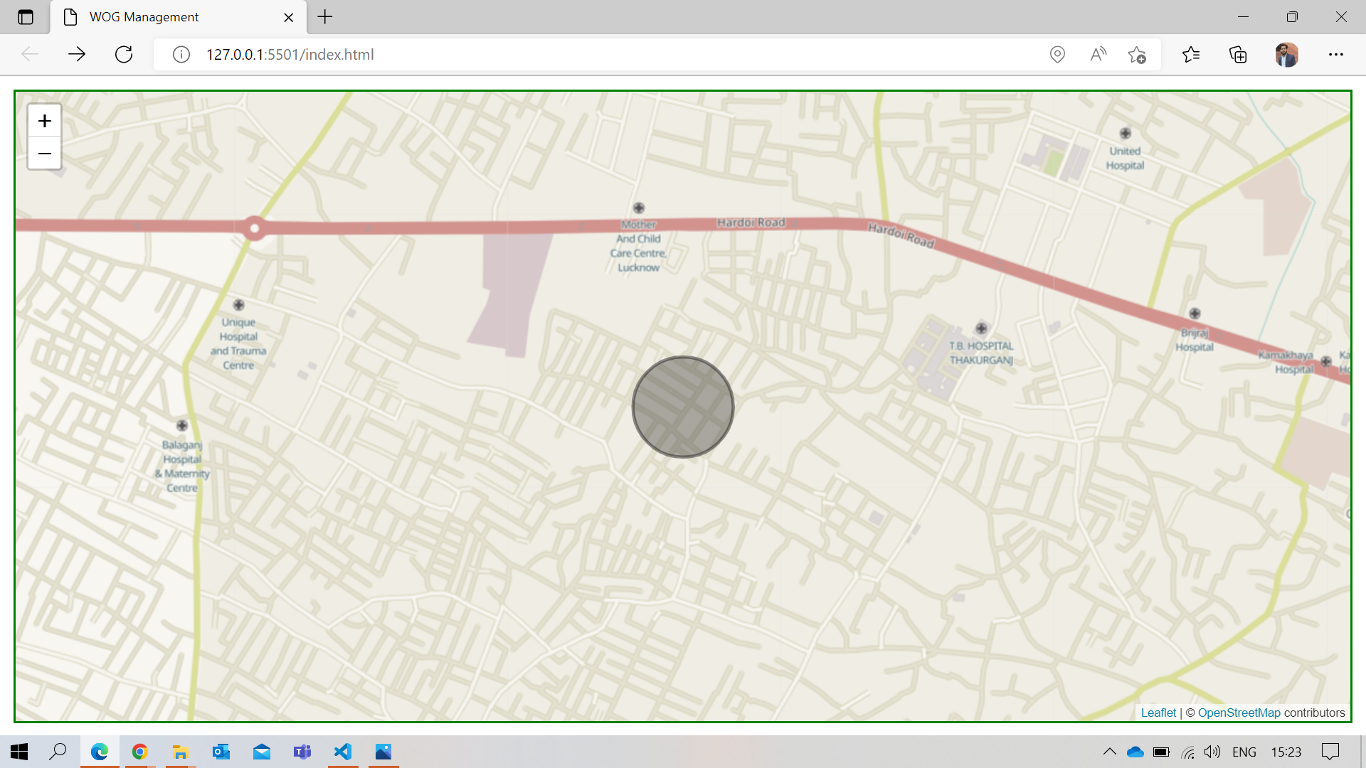
Screenshots of UI when Registering Complaint

Slide 9
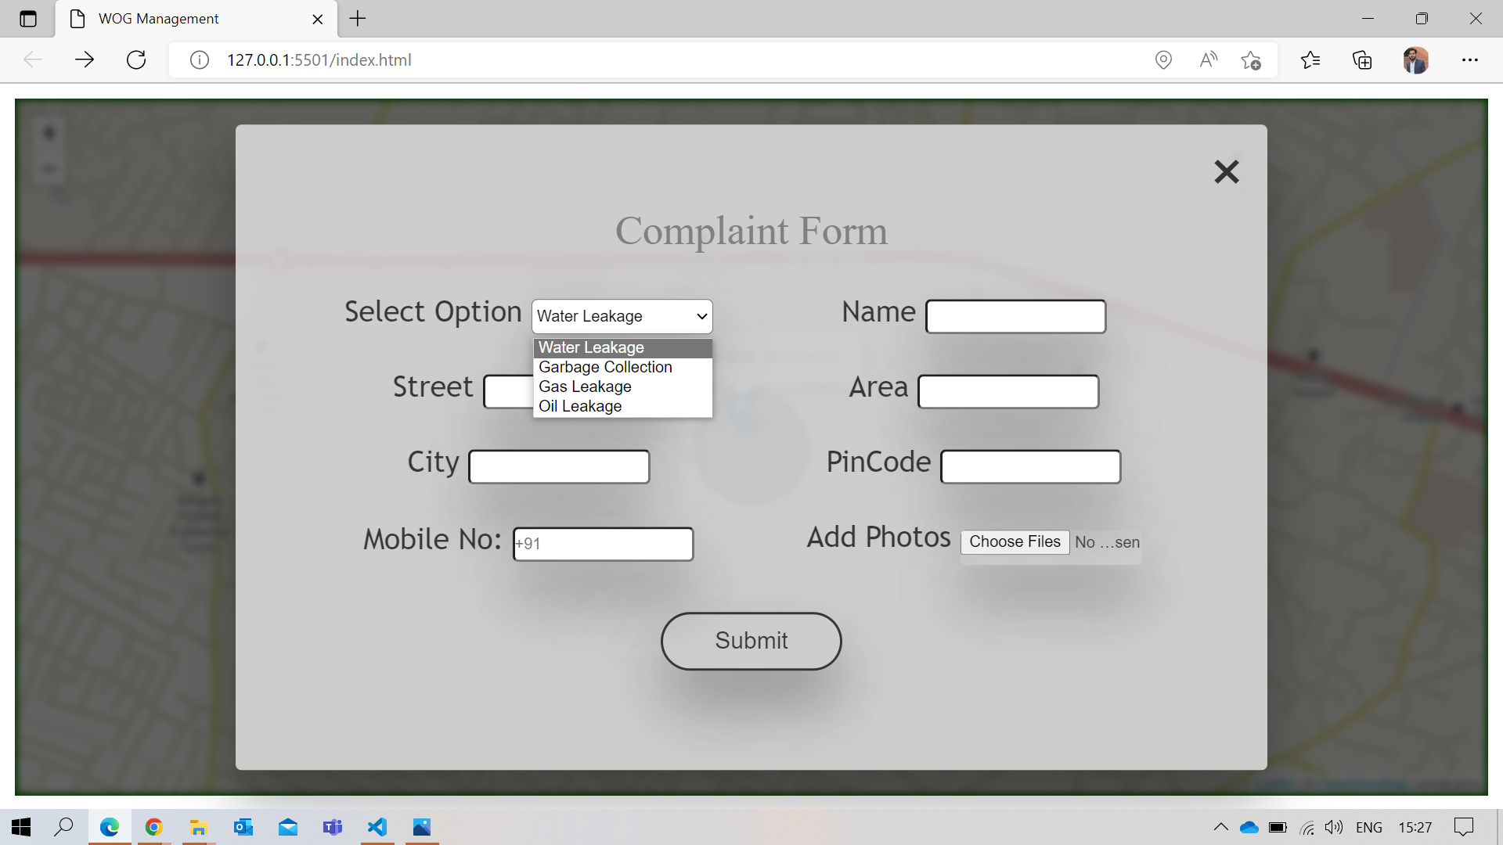
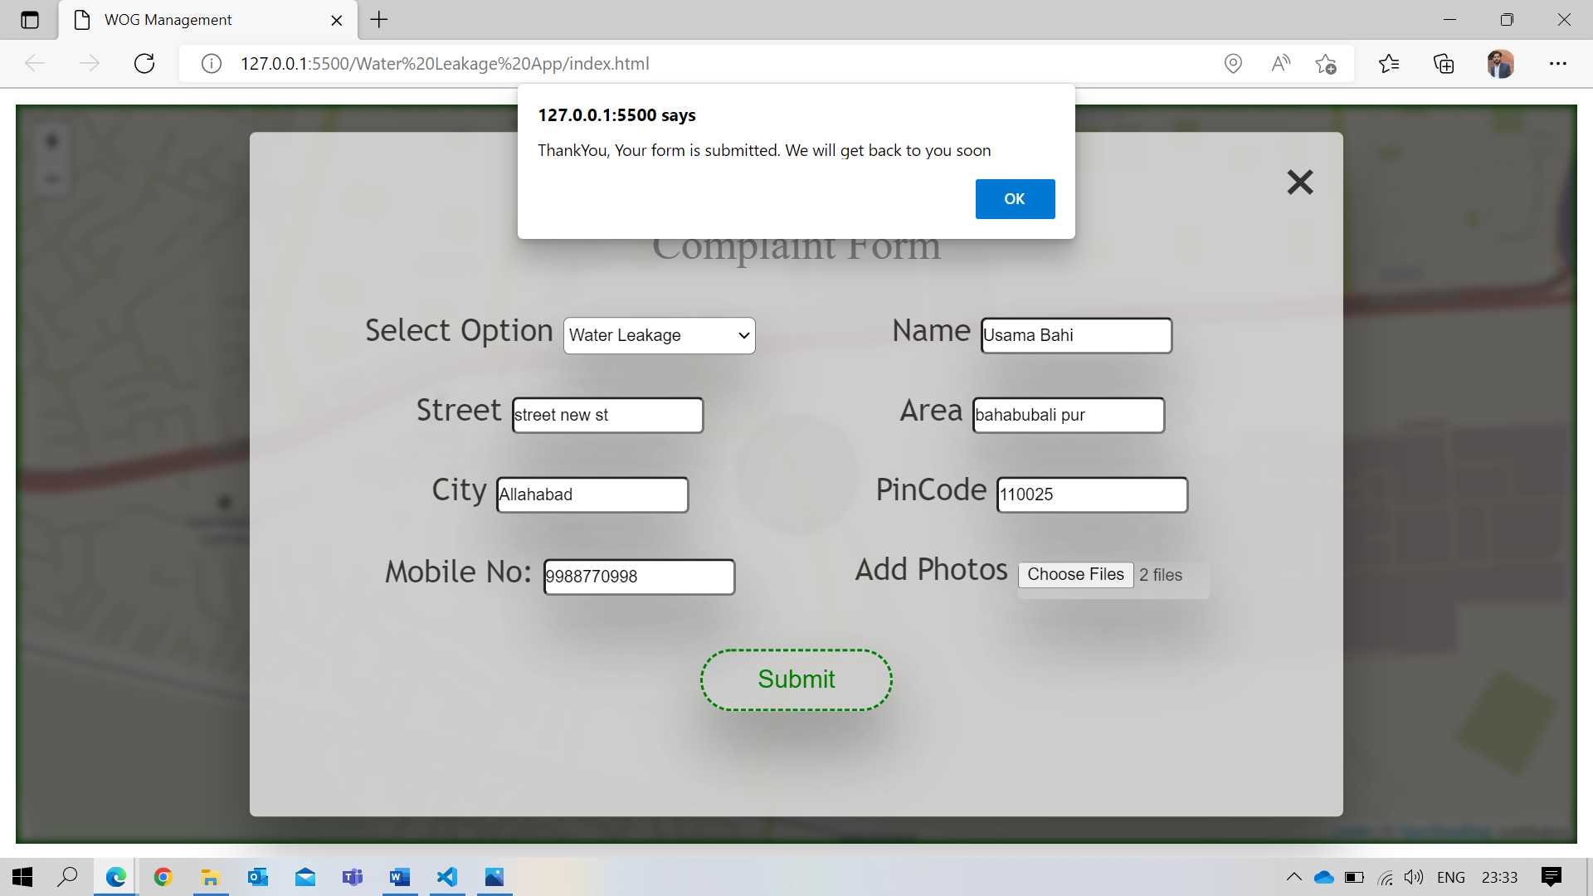

Slide 10
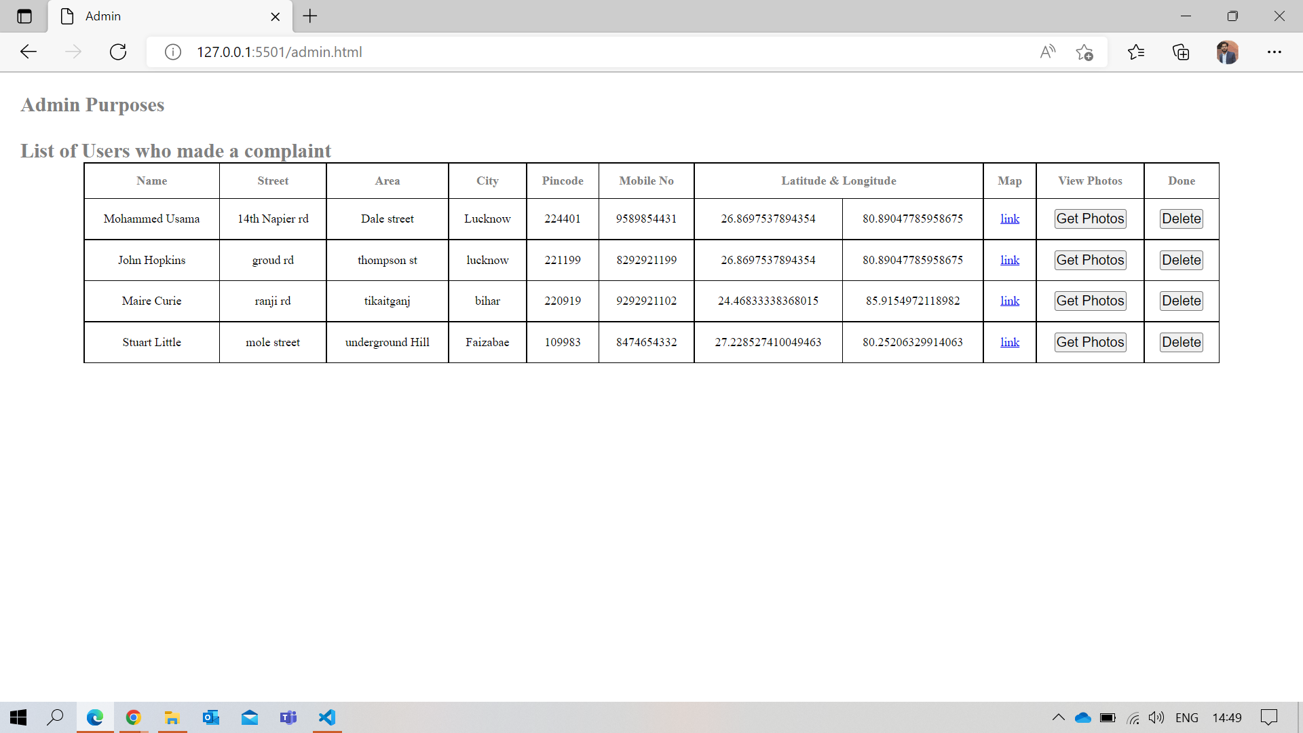
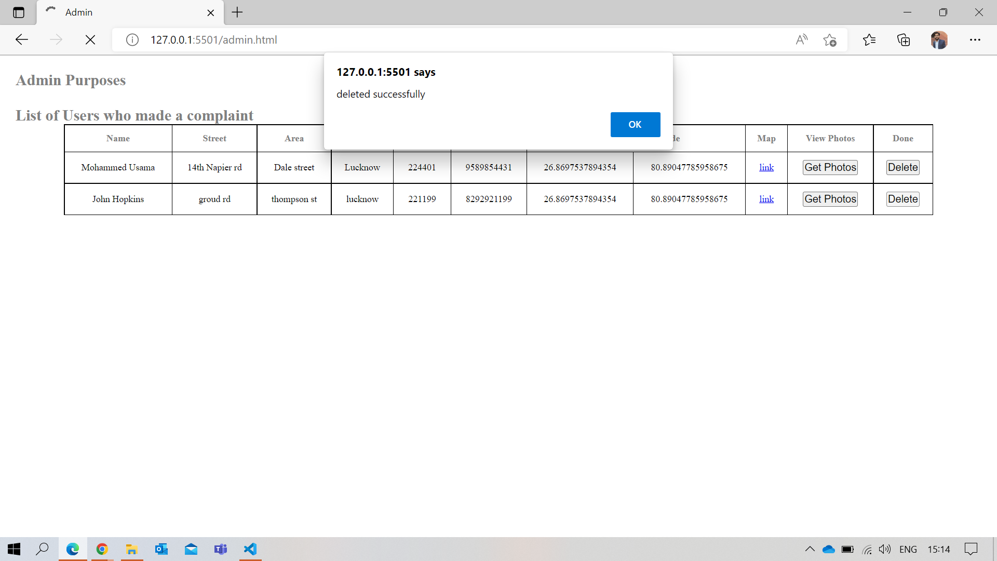
Screenshots of UI when For Admin Page

Slide 11
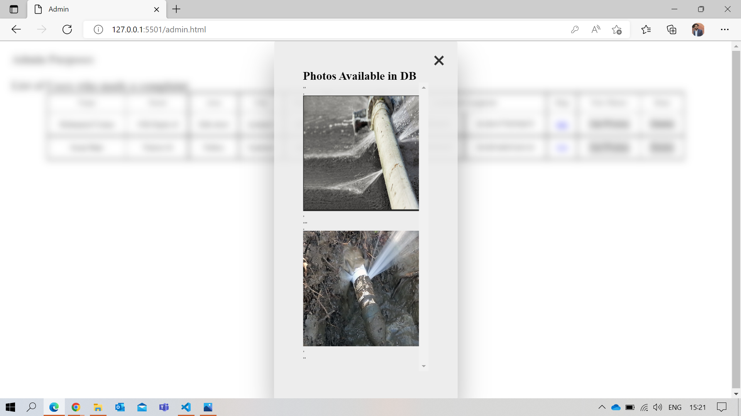

Slide 12
Thank You

